Slide 1
Pre- Final Project Presentation Design and Development of Activity Tracking System for Students on Campus Programme: B. Tech in CSE
Mentor : Hari Krishna S M
Group No. : 01
Team Leader : Rohan Purkayastha
Department : Computer Science

Slide 2
Project Team
Sl no. | Registration no. | Students
01 | 19ETCS002101 | ROHAN PURKAYASTHA
02 | 19ETCS002312 | RAHUL J KEROLLI
03 | 19ETCS002301 | ANAND M
04 | 19ETCS002054 | JYOTHI S R
05 19ETCS002088 PRATEEK J SHETTY

Slide 3
Outline
Title and Aim
Objectives
Methods and Methodology ( or Block Diagram)
Status of the Work
Results
Expected Outcomes
Cost Estimation
Gantt Chart
References

Slide 4
Title Design and Development of Activity Tracking System for Students on Campus
Aim
To design and develop a web application that tracks student activities using camera based method and provide data visualization in the form of a dashboard

Slide 5
Introduction
The Student Tracking and Visualization System (STVS) is a web-based application that can be used to monitor and visualize student activities in an e-campus and designed to help universities, colleges, and other educational institutions to monitor and assess the activities of their students.
It is designed to be used by administrators, faculty, and students to monitor and analyse student activities.
The system is designed to be intuitive and user-friendly, allowing users to quickly access the data they need.
STVS is also designed to be secure and reliable, making it an ideal solution for educational institutions looking to track and analyse student activities.

Slide 6
Objectives
To conduct a literature survey on tracking applications/systems and its method and methodologies.
To derive the functional and nonfunctional requirements based on identified survey.
To design high and low level design specification based on requirement analysis.
To develop web based application for visualization of student activities.
To test the developed application using unit testing and integration testing.
To document the report as per the template.

Slide 7
Methods and Methodology
Objective 1
To conduct a literature survey on tracking applications/systems and its method and methodologies.
1.1 To conduct a literature survey on tracking applications/systems, it is
necessary to search for available resources like books, journals, articles,
reviews, etc., that provide information on the domain area.
1.2 The resources should be appropriate and contain the latest information
about the topic.
1.3 The resources should be evaluated thoroughly and relevant information
should be extracted from them.
1.4 The information should be organized into a suitable format that can be
used for further analysis.

Slide 8
Methods and Methodology
Objective 2
To derive the functional and nonfunctional requirements based on identified survey
2.1 The gathered information from literature survey should be analyzed to
identify the functional and non-functional requirements for the tracking
application.
2.2 The identified requirements should be documented properly in order to
make sure that all the requirements are taken into consideration while
designing and developing the application.

Slide 9
Methods and Methodology
Objective 3
To design high and low level design specification based on requirement analysis
3.1 The requirements should be studied in detail to develop a high and low
level design specification.
3.2 The design specification should include the details of the user interface, the
structure of the application, the databases used and other necessary
details.

Slide 10
Methods and Methodology
Objective 4
To develop web based application for visualization of student activities
4.1 Based on the design specifications, a web-based application should be
developed.
4.2 The application should be developed using appropriate technologies and
tools.
4.3 The application should be tested properly to make sure that it is working as
expected.

Slide 11
Methods and Methodology
Objective 5
To test the developed application using unit testing and integration testing
5.1 The application should be tested using unit testing and integration testing
to make sure that it is functioning properly.
5.2 The application should be tested thoroughly to ensure that all the features
are working as expected.

Slide 12
Methods and Methodology
Objective 6
To document the report as per the template
6.1 The developed application should be documented properly as per the
template.
6.2 The documentation should include the details of the application, its
features, the testing results, and other relevant information.

Slide 13

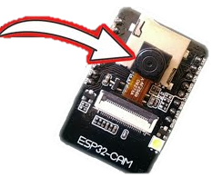
High Level Diagram
Students Esp32 Camera Application
Face Recognition Dashboard Activity Tracker
Database

Slide 14
Literature Survey
RESEARCH PAPER | JOURNAL | AUTHORS | PUBLISHING YEAR
Face Recognition Based Attendance System | IJEAT | Nandini R, Duraimurugan N, S.P.Chokkalingam | February 2019
Iot Based Live Student Tracking System | IJRTE | Rahul Gandhi. A, Sanjay. C, Vasanth. S, Senathipathi. K | May 2020
Real Time Student Tracking System Using RFID Tags and IOT Enabled Device | IRE | PRANITA KADAM, RAHUL PATIL, MANSHU VISHWAKARMA, RAJESHRI ANEESH | April 2020
FACE DETECTION BASED ATTENDANCE SYSTEM USING ESP32 | (UGC Care Group I Listed Journal) | K.N.Divya Bhargavi, Dr. M.Ranga Rao, P.V.V.N.D.P. Sunil. | February 2021
Design of an IOT System based on Face Recognition Technology Using ESP32-CAM. | IJCSNS | Ines Mahmoud, Imen Saidi, Chadi bouzazi | August 2022

Slide 15
Functional Requirements
FR1 – The system should allow the admin to Add student registration using registration number and profile photo.
FR2 – The system should capture student identity in real time and perform face Detection and recognition.
FR3 – The system should store the Identified student details along with camera location.
FR4 – The system should provide a dashboard to get the student statistics in real time.
FR5 – The system should allow the admin to get student activity data using registration number.

Slide 16
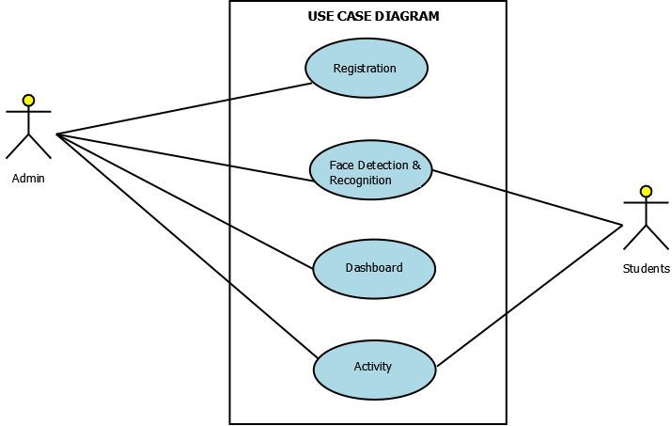
Low Level Diagram
Use Case Diagram:

Slide 17
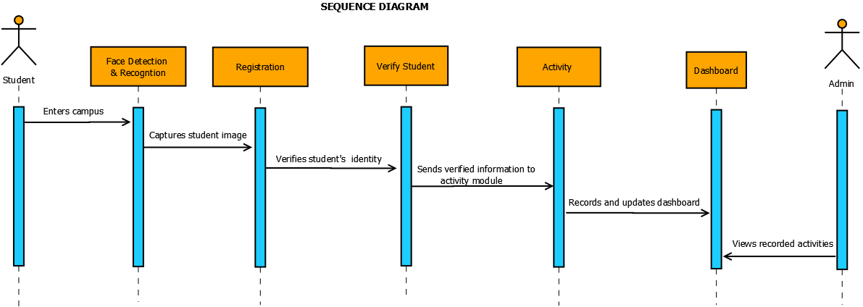
Sequence Diagram

Slide 18
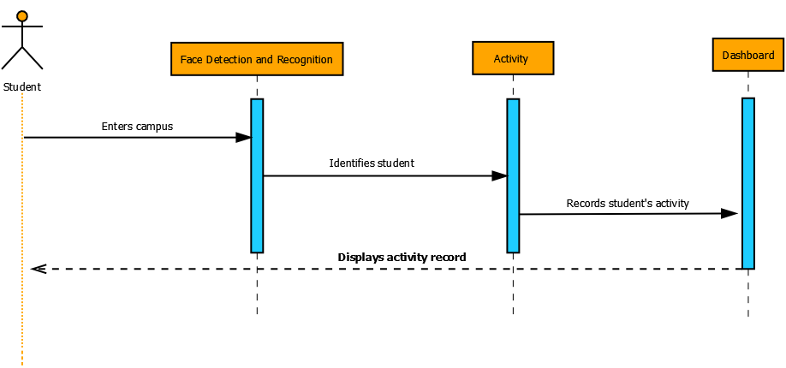
Sequence Diagram
Student:

Slide 19
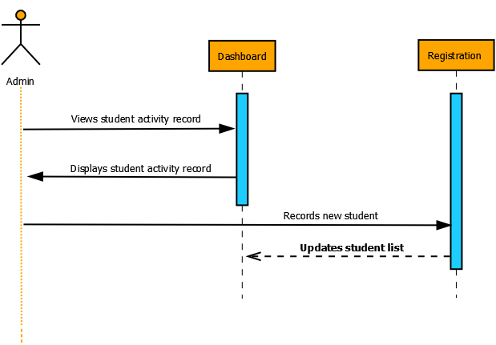
Sequence Diagram
Admin:

Slide 20
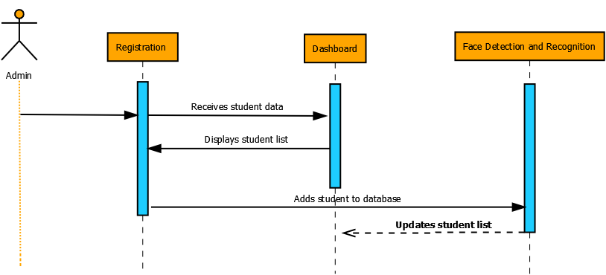
Sequence Diagram
Registration:

Slide 21
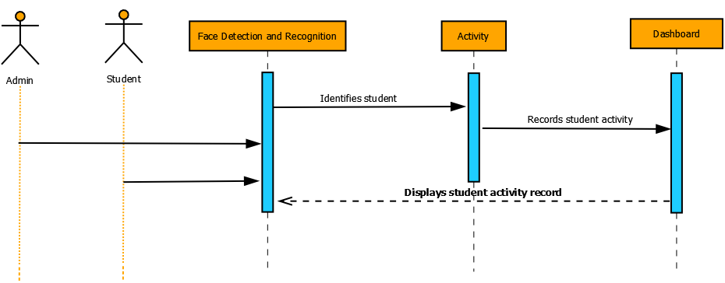
Sequence Diagram
Face Detection and Recognition

Slide 22
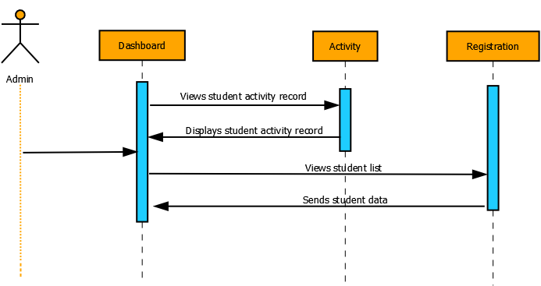
Sequence Diagram
Dashboard:

Slide 23
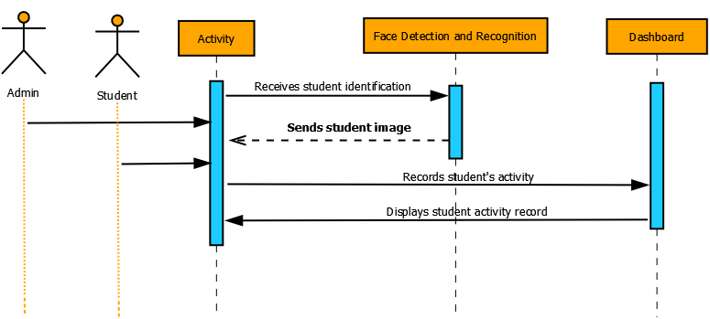
Sequence Diagram
Activity:

Slide 24
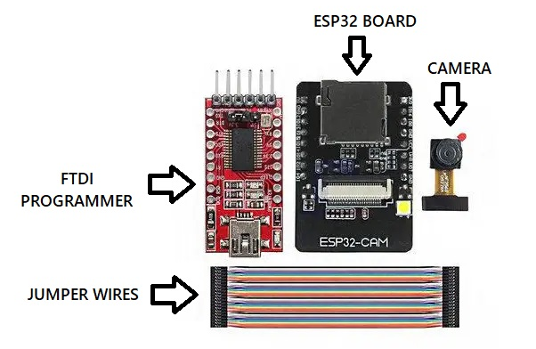
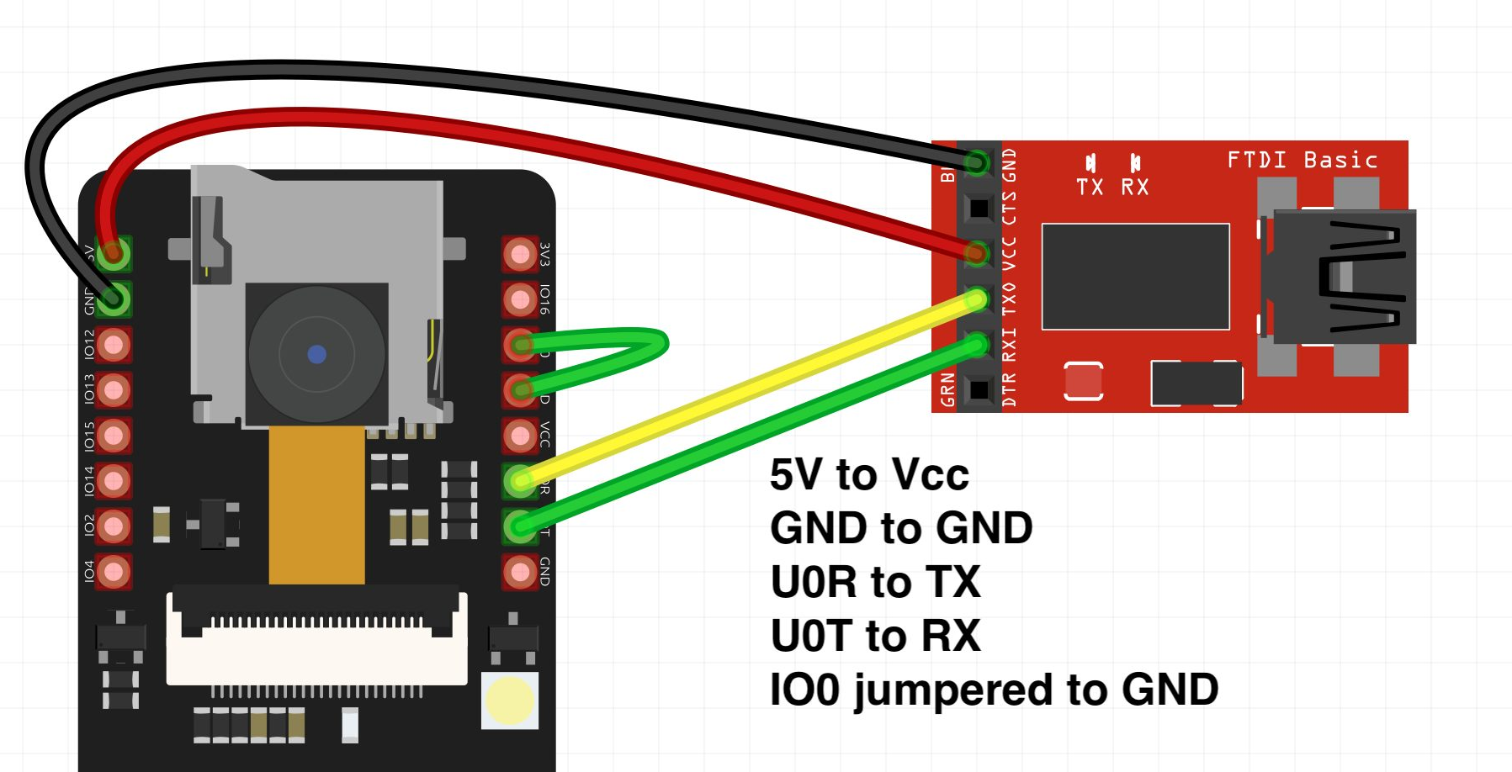
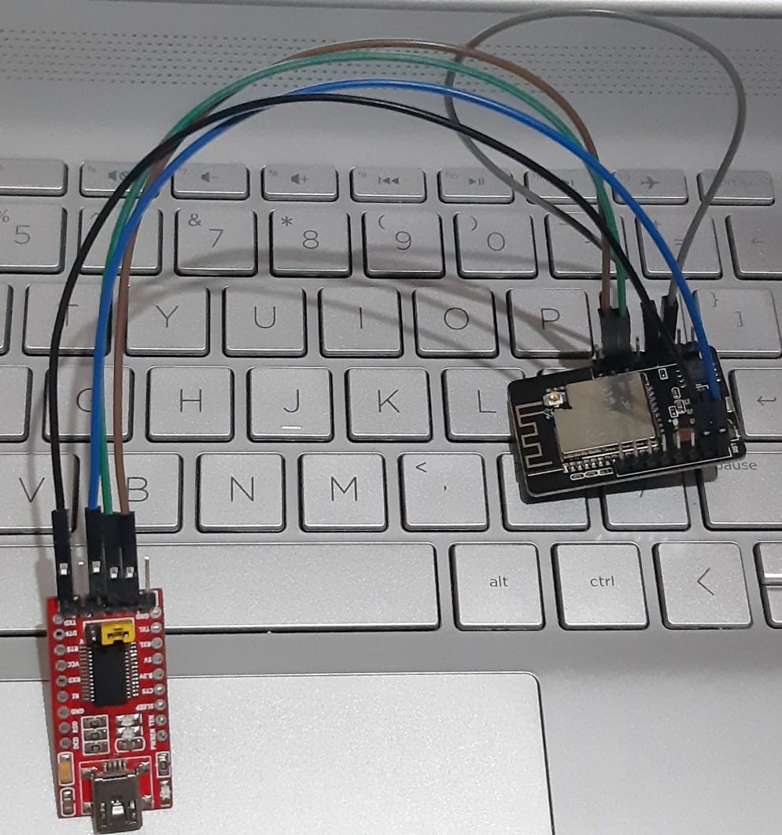
Connection between the ESP32 CAM board & FTDI Programmer

Slide 25
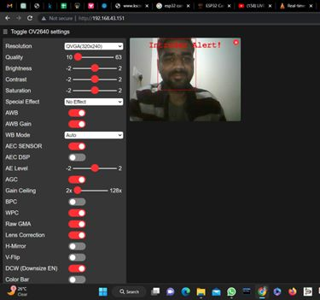
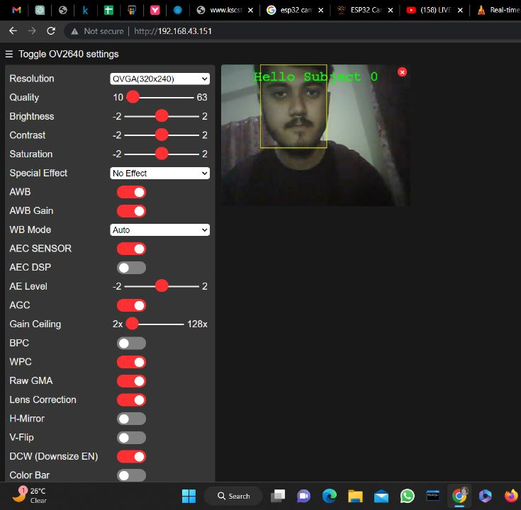
ESP32 Camera Streaming test
Before Face Enrollment After Enrolling
(Intruder alert) (Hello Subject 0)

Slide 26
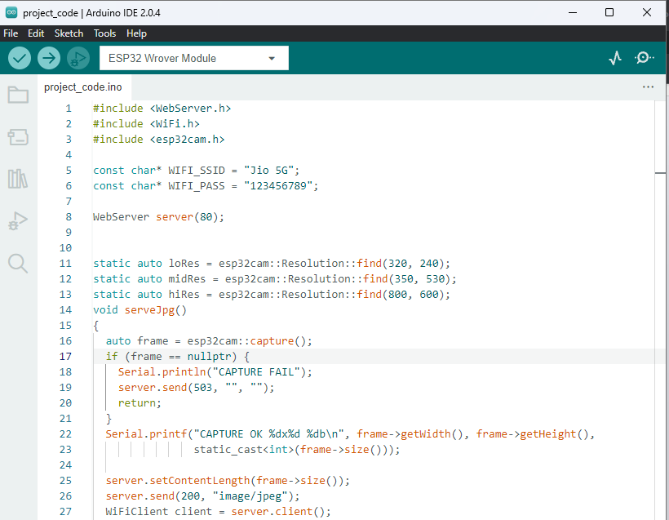
Updated source code for ESP32 CAM Module in Arduino IDE

Slide 27
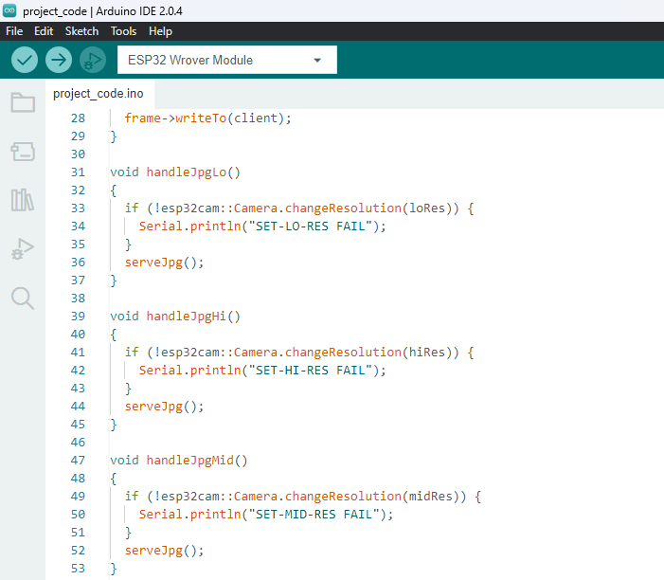
Continuation code

Slide 28
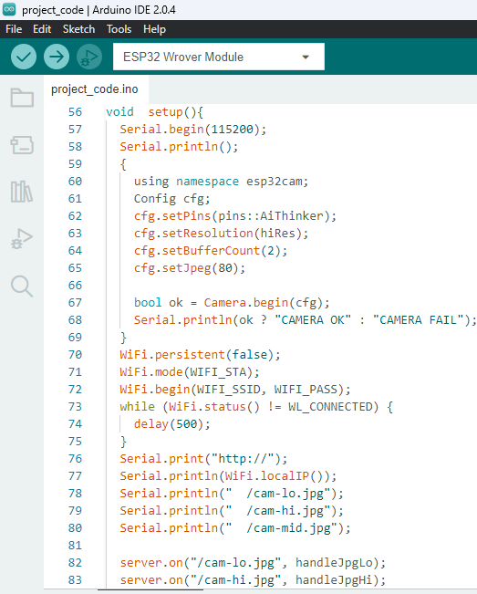
Continuation code

Slide 29
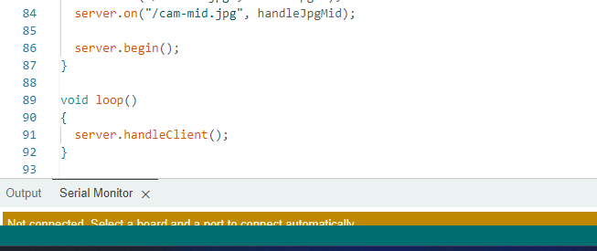
Continuation code
Compiling and uploading it to the ESP32 CAM Board we should the steps as follows:
Make sure the IO0 pin is shorted with the ground when you have pressed the upload button.
If you see the dots and dashes while uploading press the reset button immediately
Once the code is uploaded, remove the I01 pin shorting with Ground and press the reset button once again.
If the output is the Serial monitor is still not there then press the reset button again.

Slide 30
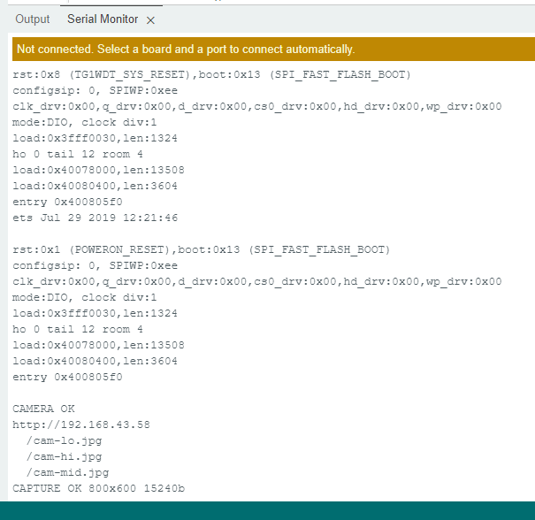
Getting the IP address
After uploading the code, disconnect GPIO 0 from GND.
Open the Serial Monitor at a baud rate of 115200.
Press the ESP32-CAM on-board Reset button.
The ESP32 IP address will be printed in the Serial Monitor.

Slide 31
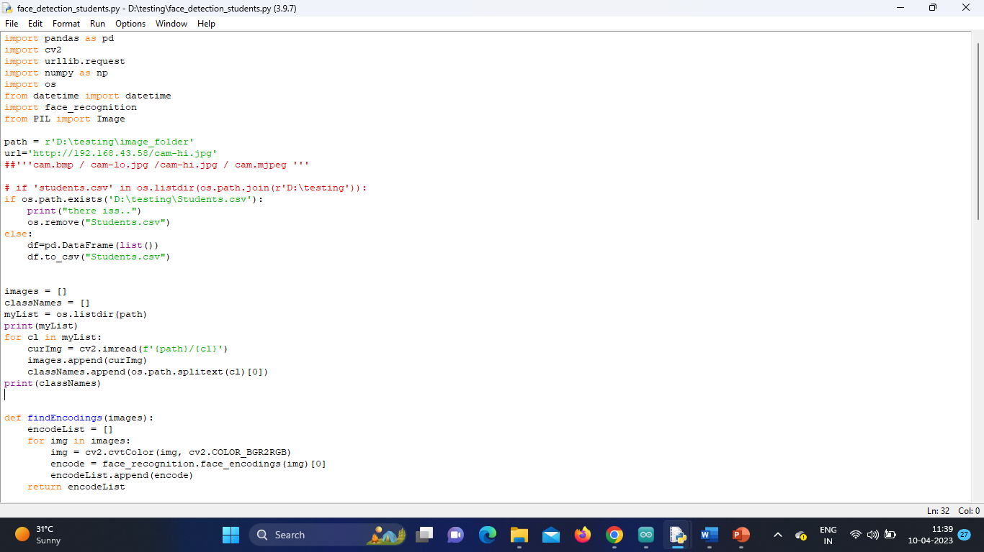
Python Code for Face Detection & Recognition System

Slide 32
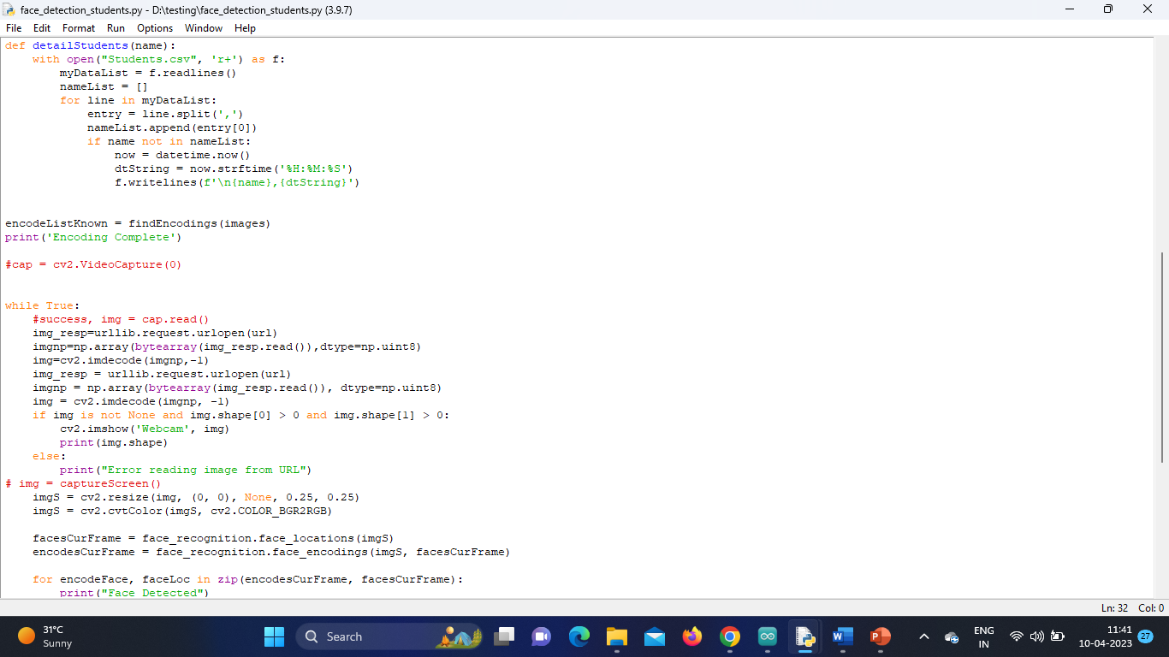
Continuation code

Slide 33
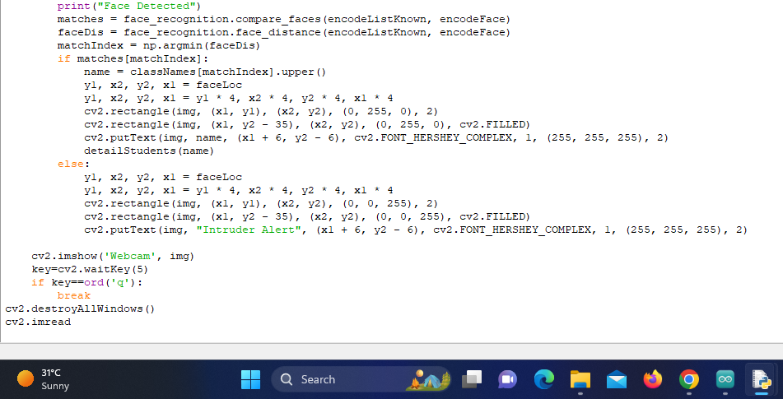
Continuation code

Slide 34
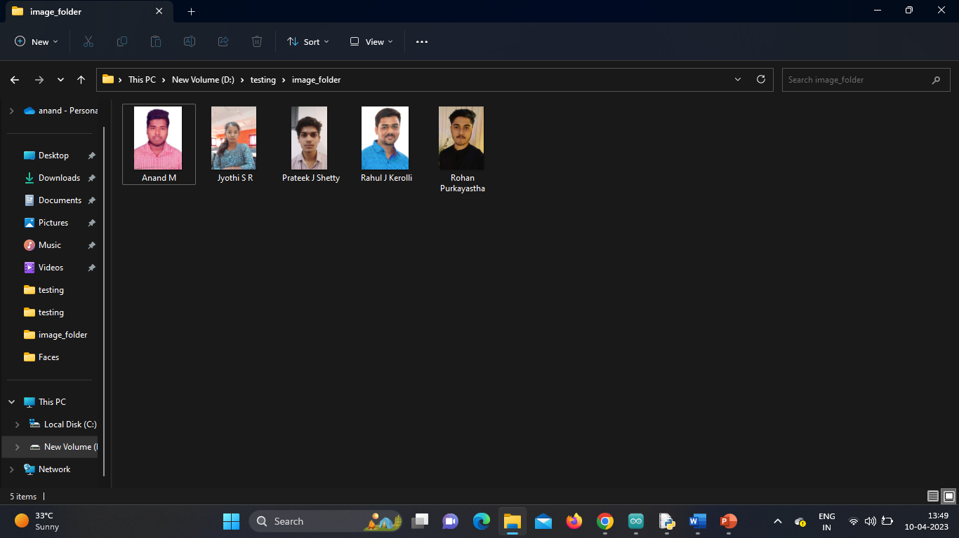
Database

Slide 35
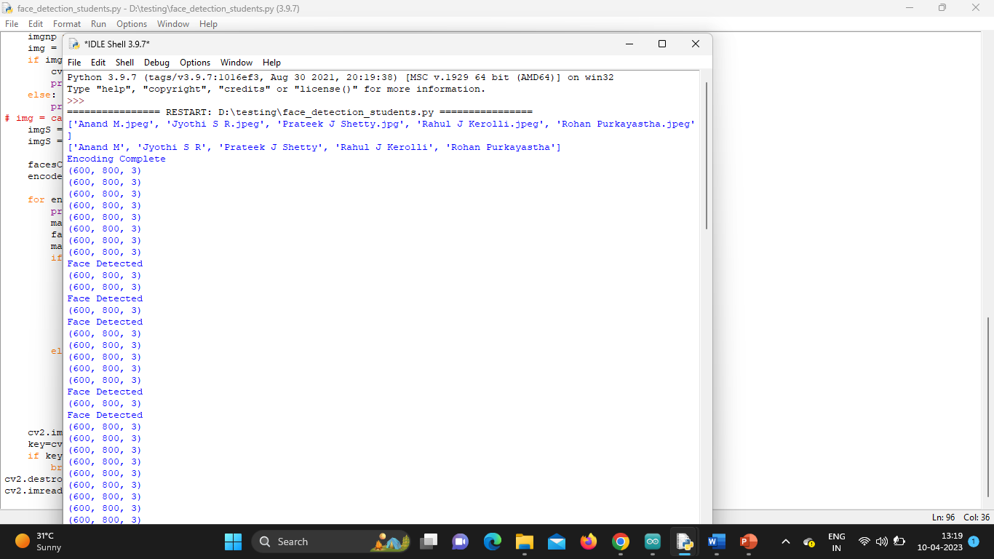
Real-Time Streaming Results
Captured image is compared with database image if face matches student details is displayed

Slide 36
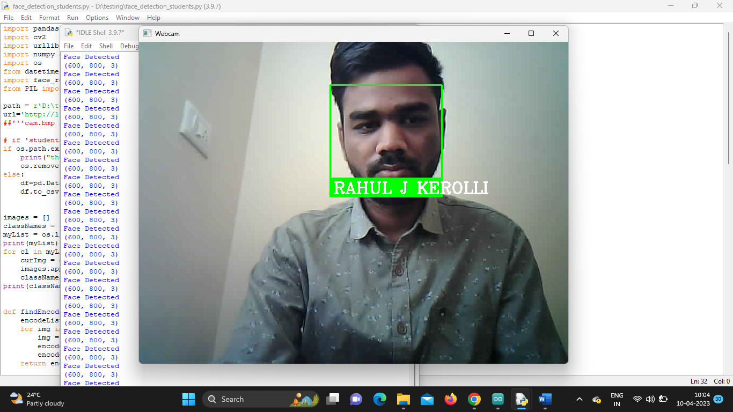
Results
Face has been Detected

Slide 37
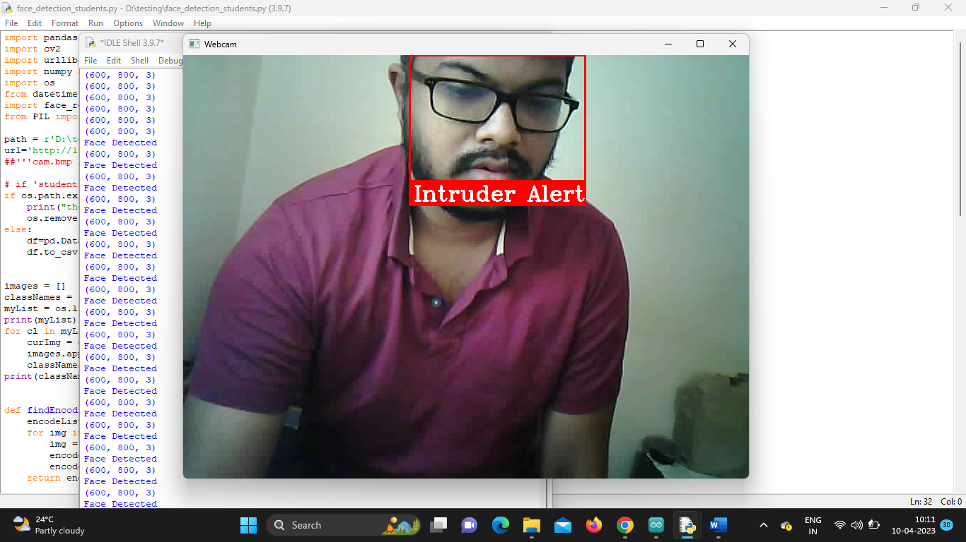
Results
Intruder Alert

Slide 38
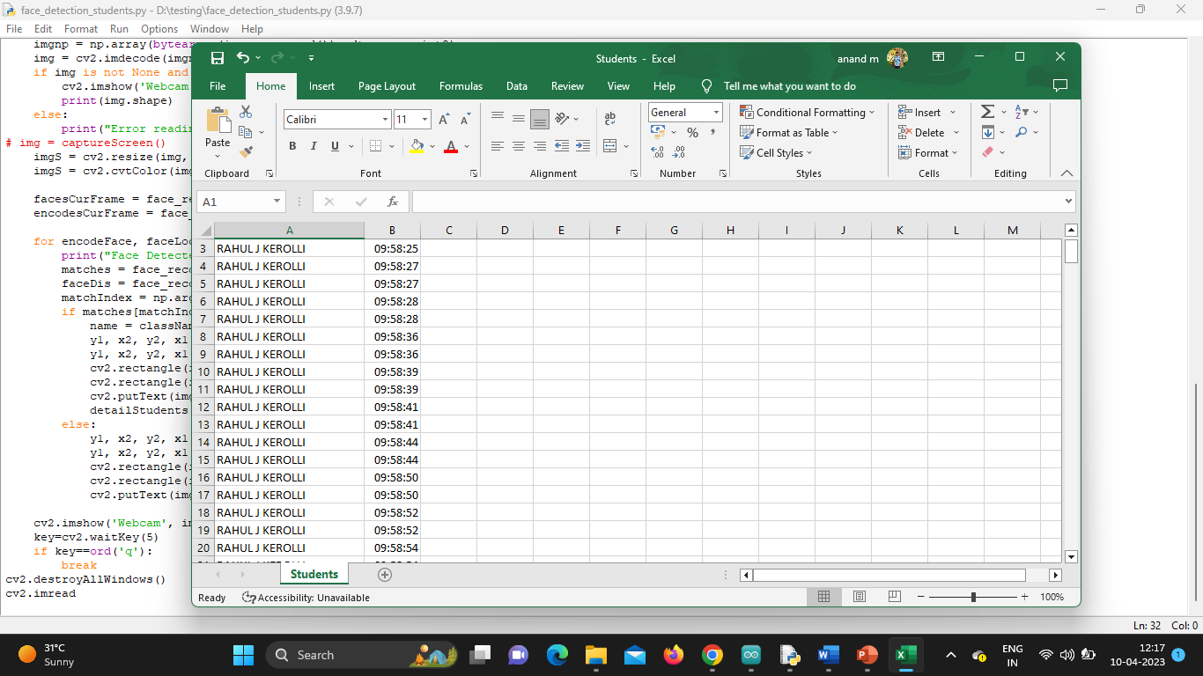
Results
The validation of the presence system which is presented in the form of an excel file

Slide 39
Expected Outcomes
Demonstration of Activity Tracking model
Dashboard to display real-time statistics

Slide 40
Cost Estimation
S.No. | Particulars/Components/Devices | Estimated Cost
1 | ESP32 Camera 2MP | 550
2 | FTDI Programmer Board with Cable | 220
3 | Jumper Wires | 150
4 | Laptop
Total: Rs.920
Man hours:
Man hours per week (students): 18 *5 students =90
Man hours per week (faculty): 3

Slide 41
Gantt Chart
Project Work (UG) 16 weeks
Week | 1 | 2 | 3 | 4 | 5 | 6 | 7 | 8 | 9 | 10 | 11 | 12 | 13 | 14 | 15 | 16
Major Activities
1.1
1.2
2.1
2.2
2.3
2.4
3.1
3.2
4.1
4.2
5.1
5.2
6.1
6.2

Slide 42
References
Research Papers: Relevant academic research papers could provide insights into the latest developments and best practices in the field. Some popular databases to search for such papers include Google Scholar, IEEE Xplore, and ACM Digital Library.
Luciano, R. G., Alcantara, G. M., & Bauat Jr, R. (2020). Design and Development of Alumni Tracking System for Public and Private HEIs. International Journal of Scientific & Technology Research, 9(06).
Stakeholders’ attitudes towards the installations of closed-circuit television cameras in reducing school violence 2022, Heliyon
The Impact of Technological Advancements on Educational Innovation (VSI-tei)
Qureshi, Kashif Naseer, Ayesha Naveed, Yamna Kashif, and Gwanggil Jeon. "Internet of Things for education: A smart and secure system for schools monitoring and alerting." Computers & Electrical Engineering 93 (2021): 107275.

Slide 43
Thank You

